Slide 1
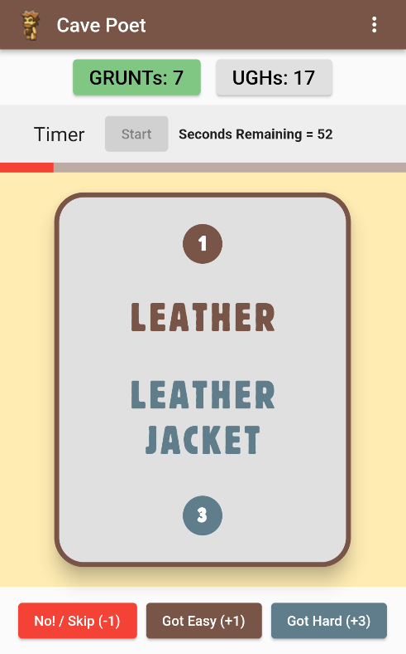
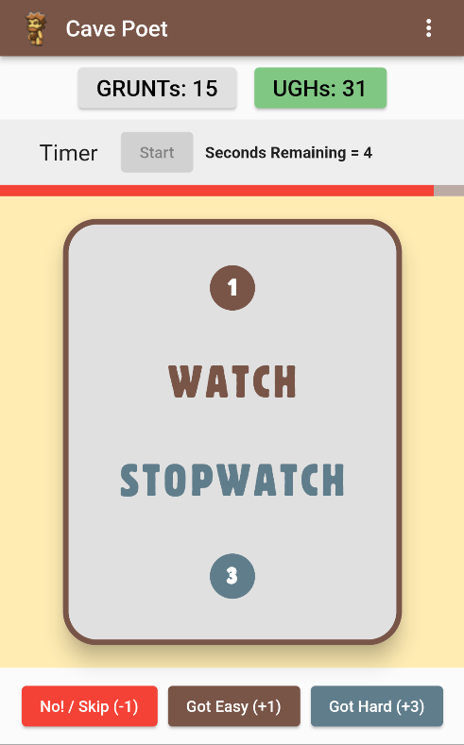
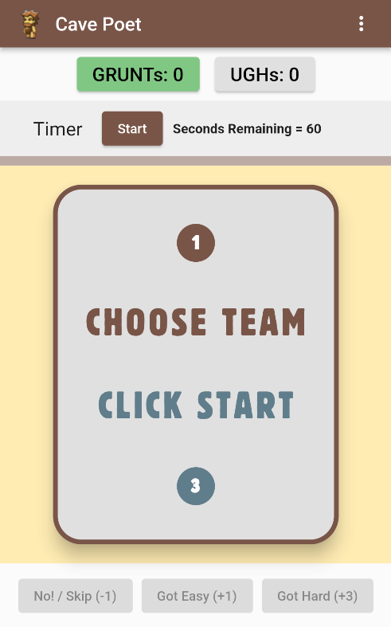
quick!
You have 60 seconds!
GO!
Give 1-syllable clues
Easy? 1 point
Get READY...–
MAKE 2 TEAMS
Dry cow skin.
Hard? 3 points!
Wear when cold.

Slide 2
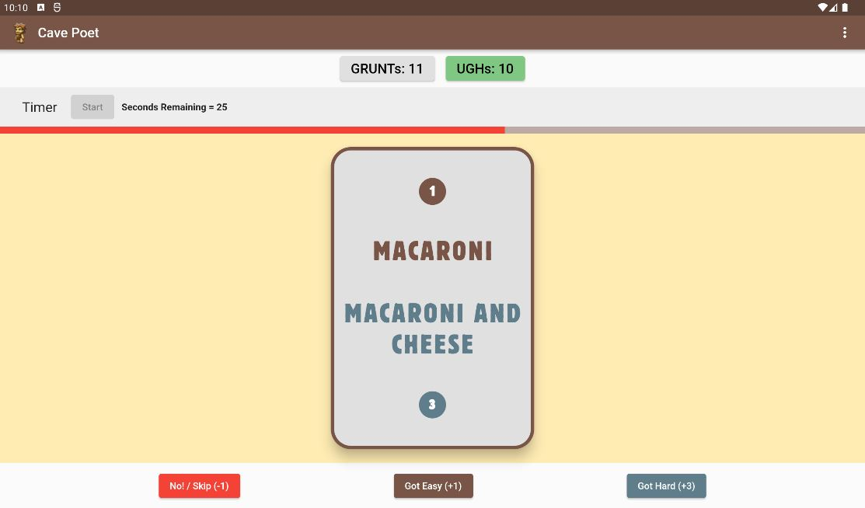
Tablet friendly!

